Slide 1
Leading Quality: Thoughts for Trustees and Other Leaders
Carol Beasley, Vice President Director IMPACT Network Institute for Healthcare Improvement

Slide 2
Overview
Introduction to IHI and IMPACT
Framework for Trustee role in quality
Inquiry: What do our communities expect?
Discussion: Moving the “big dots”

Slide 3
Evolution of IHI
Movement
Redesign
Collaborative Improvement
Education
Awareness

Slide 4
Changing Health Care
POLITICAL
“Old Boys’
Club”
Productive
Change
Technocracy
SOCIAL
TECHNICAL
IMPACT

Slide 5
IMPACT Theory
Leadership and System Transformation
Improvement on the front lines

Slide 6
IMPACT Present and Future
Now:
175 organizations; 226 teams
9 topic areas + Leadership
Mainly hospitals and systems
Most in US, few in Canada, UK
Tomorrow
225 organizations; 300 teams
Add innovation communities
Larger groups of hospitals and regions
Greater geographic diversity

Slide 7
Current Vermont Participation
BTS: Surgical Site Infections | Brattleboro*, Fletcher Allen, Northeastern, Northwestern, Porter
BTS: Adverse Drug Events | North Country, Southwestern
BTS: Access | Grace Cottage*, Mt Ascutney
IC: Flow | Central Vermont, Copley*, Rutland, (Fletcher Allen, formerly)
IC: Planned Care | Gifford*
Spread | Springfield

Slide 8
Leadership of Quality

Slide 9
Trustee Leadership
Understand the important things your community expects from your hospital
Establish a few system-level measures of those important things (Big Dots)
Link improvement of the Big Dots to strategic plan
Build hospital’s will, ideas, and execution to move the Big Dots
Maintain constancy of purpose
Promote collaboration across the community for redesign of care

Slide 10
Trustee Leadership
Understand the important things your community expects from your hospital
Establish a few system-level measures of those important things (Big Dots)
Link improvement of the Big Dots to strategic plan
Build hospital’s will, ideas, and execution to move the Big Dots
Maintain constancy of purpose
Promote collaboration across the community for redesign of care

Slide 11
What does your community expect?
Safety
Effectiveness
Patient-centeredness
Timeliness
Efficiency
Equity
Notes:
Ask a couple of hospitals to state their current mission/vision with respect

Slide 12
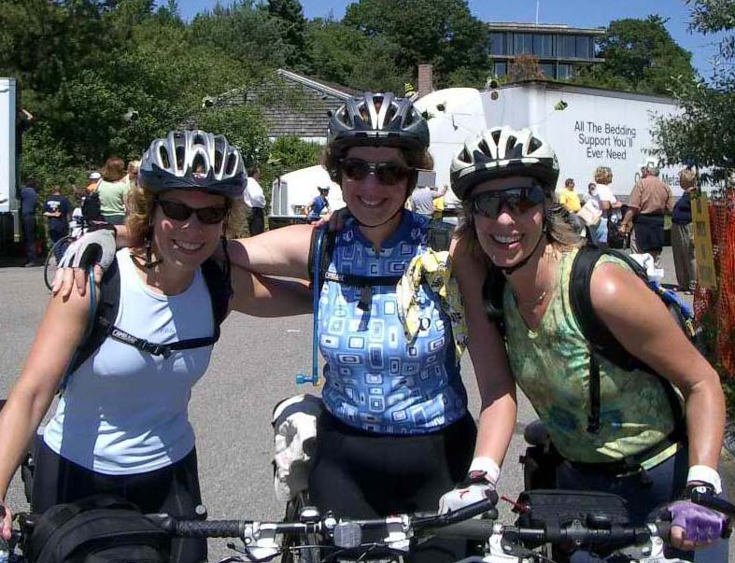
Team Beasley

Slide 13
Polycythemia Vera
Chronic myeloproliferative disease
Increases in red cells, leucocytes and platelets, hypercellular bone marrow and splenomegaly
Hemorrhagic or thrombotic events; splenomegaly, leukemia.
Treatment:
Phlebotomy, radioactive phosphorus, hydroxyurea

Slide 14
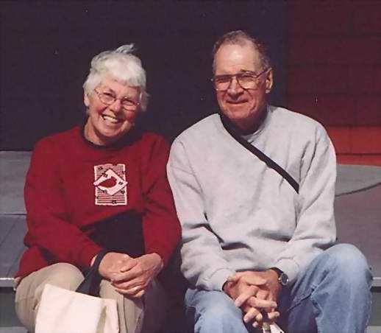
Pat and Alan
Notes:
Mom – 75 y.o. She and my dad have been married almost 53 years. Mother of 4. Retired elementary school teacher. She’s the kind of teacher that students remember their entire lives. She is smart, confident, energetic. Loves gardening, reading, quilting, crosswords. Goes to low-impact aerobics. She’s generally very healthy – high blood pressure, osteoarthritis.
Told us on Mother’s Day. “Do you think I should tell the kids what’s going on?”
Polycythemia Vera.

Slide 15
Our Concerns
Understanding the disease and treatment (Safety and Effectiveness)
Supporting Mom through treatment (Patient centeredness)
Anticipating other support she may need now or in the future (Effectiveness, Timeliness)
Making sure she retains the amount of control she wants (Patient centeredness)
Notes:
Introduce Don Video: Every year at the National Forum, Don Berwick’s plenary address is a highlight. His speeches are often very personal, and this is no exception. As you watch the video,

Slide 16
Individual Reflection
Who is the person and what is their relationship to you?
Describe this person
Describe their health challenge
What are some major concerns?
In what areas of quality do their concerns occur?
Notes:
I’ll give you about five minutes to think about a specific person and a specific situation – don’t generalize.
At your table have a couple of volunteers tell a bit about the person they chose. You don’t HAVE to share any information about the person in your life, and you should definitely not share any information that you don’t feel comfortable about sharing.
Don’s videotape – Listen through the lens of the person you chose to reflect upon.

Slide 17
What our patients want…
Cure me
Heal me
Don’t hurt me

Slide 18
System Level Results: Focusing on the “Big Dots”

Slide 19
Measures of Clinical Quality
How many clinical quality measures or indicators do you deal with in a typical month?
Greater than 50
25-50
11-25
6-10
1-5
Zero
Notes:
How many of these measures are measures of the “Big Dots” – system level measures of safety, effectiveness, patient-centeredness, timeliness, efficiency, equity?

Slide 20
The primary question is:
How good are you at measuring, aiming at, and improving whole system measures?

Slide 21
Approach
Balanced set of metrics that “people care about”
Monthly trends over time
Build on existing data sources
Cover the entire system rather than detailed measures of one component

Slide 22
IOM Dimensions and Measures
IOM Aims | Measures
Safe | Adverse drug events Work days lost
Effective & Equitable | Hospital specific mortality Functional outcomes
Patient- centered | Inpatient satisfaction % Patients dying in hospital
Timely | 3rd available appointment
Efficient | Hospital costs per discharge Health care costs per capita

Slide 23
Hospital Standardized Mortality Rate (HSMR)
A methodology to determine death as a defect versus death as the end of life’s journey
that
Adjusts a hospital’s mortality based on case mix characteristics at a patient level
and
Adjusts a hospital’s mortality based on community characteristics

Slide 24
Reimbursement vs. HSMR (Random 250 Hospital Sample from 2,166 Larger Avg Hospitals) “Move the Dot”

Slide 25
Discussion Questions
What Whole System Measures are you currently tracking?
Are these measures tied directly to your strategic plan?
For which of these measures has your board adopted, How High by When aims?
With or without an Aim, make a prediction about the future performance of each measure you have identified (e.g., improve, stay the same, get worse).
With your current plan, are you going to achieve your desired level of performance (i.e., move the Big Dot)?

